Slide 1





Augmenting customer service in a Restaurant web application using React-JS
Group members
Aditya Cherukuri
Karthik Rangaraj
Mrudula Ravipati
Sai Sandeep Duddukuri
Vinatha Kotapati
Viswa Teja Adabala

Slide 2
Project AIM
The project's main goal is to provide a forum for customers to get a good picture of the restaurant. Potential customers need to know what to expect when they visit our restaurant, so the web application includes all the necessary information, such as the restaurant's ambiance and the food menu, which lists the various dishes available. It allows customers to leave suggestions that can help the restaurant enhance the quality of the dishes and provide better customer service.
It also allows customers to read reviews about the restaurant so that they can get a better understanding about what most other people like about it. Customers may make a reservation by providing their information and selecting time slots to reduce long wait times. It also includes the restaurant's address and contact details, which can be useful to customers if they have any questions.

Slide 3
React History
React is a widely used open-source JavaScript library that uses HTML to display data. It's also known as ReactJS and React.js. It's also known as "Facebook React.js" because it was created by Facebook. Instagram, Facebook, and group developers who are involved in the library are currently maintaining it.
In 2011, Facebook's engineers started to run into several problems with code maintenance. With the number of features in the Facebook Ads application, the team needed more people to keep it running smoothly. As an enterprise, the growing number of colleagues and application highlights slowed them down. Their application became difficult to manage over time as a result of a large number of dropping changes.
Engineers at Facebook eventually couldn't keep up with the dropping alerts. Their code demanded a rapid advancement in order to become more proficient. They had the model right, but they didn't account for the client experience. As a result, Jordan Walke put together a model that improved the cycle's efficiency, which marks the implementation of React.js.

Slide 4
Language Evolution
2010: The beginnings of React
2011: An early version of React
2012: At Facebook, something exciting had begun
2013: Great Launch
2014: Expansion
2015: Year of Stability
2016: Increasing popularity
2017: Enhancement

Slide 5
React Language
React is a JavaScript library for designing user interfaces that is declarative, powerful, and scalable. Instead of directly altering the browser's DOM, React creates a virtual DOM in memory, where it performs all of the necessary manipulation before performing the changes in the DOM browser. Each module in a react program is responsible for rendering a tiny, reusable piece of HTML. Components may be nested inside other components to enable complex applications to be built out of simple building blocks.

Slide 6
React Primitive Datatype and Reserved Words
A primitive data type in React is data that isn’t an object and doesn’t have any methods. There are six primitive data types in React which are boolean, String, int, number, undefined and symbol.
The following reserved words cannot be used as variables, labels, or function names in JavaScript: arguments, abstract, await, boolean, const, catch, case, debugger, interface, implements, switch, synchronized, this, throw, transient and void.

Slide 7
React Abstraction
Composition is used to build abstractions in React. Higher-level components bring together standard lower-level components in a user interface. A button, for example, may be part of a feedback type that is part of the contact page. Each level conceals relevant logic inside the component while exposing required parts on the outside.
For example, if we have a component that controls an accordion, we can reuse it rather than rewriting it when we want an accordion to appear on the screen. We may need a new design or features, but we can reuse the base functionality as long as the accordion in a screen behaves as an accordion.

Slide 8
Readability, Writability, Reliability of React
In this scenario, the positive aspects of React become negative. The size of the JSX code increases in unison with the size of the application and code, making it increasingly difficult to handle and read. While it is historically considered a poor practice to mix HTML and Javascript, React makes use of JSX and demonstrates how versatile it can be. However, there are drawbacks. When developing larger applications, code readability suffers significantly.
In terms of code writability, React gives us more versatility and power. We can add classes, delete classes, add styles, and remove styles on the fly with great ease in react. When developing broad applications, style scoping is a critical consideration. Style encapsulation is not available in React. It expects the user to assign each item a unique class name.
The virtual DOM in React improves the user experience and speeds up developer work. In React JS, we can reuse code elements, which saves us a lot of time.

Slide 9
Pros of React
Virtual DOM,
Value for money,
SEO-friendly,
Component reusability,
Enhanced user experience,
Speed and performance improvement,
gradual learning curve and ease of use,
ease of creating Dynamic Web Applications,
handy tool support and test friendly.

Slide 10
Cons Of React
Although React is attractive it does have a few cons which are its
fast-paced development,
UI having a shallow focus,
lacking documentation and JSX which acts as a barrier.

Slide 11
Implementation
React-JS is used in the implementation of this project. Web applications are well known for evolving and changing daily to enable more functionality and enhancements.
As a result, we chose React-JS to satisfy the increasing demand. Since we will be using JSX syntax, which is simple and easy to render the components, React-JS increases the productivity and maintenance of the code.
Even when creating a high-load software, React ensures that the code is consistent, and that the DOM is rendered quickly.
So, in React, all changes are first introduced to the virtual DOM, and then only the operations that modify the interface are applied to the real DOM using the diff algorithm. This method of rendering is faster and offers a better experience for users as well as high performance.

Slide 12
Implementation
React's one-way data coupling makes it modular and straightforward. When a developer creates a React app, they frequently nest child components inside parent components due to the unidirectional data flow.
This way, a developer can see exactly where a mistake occurs, giving them greater control over the whole web application.
Stateful class components and Stateless functional components are used to build the restaurant web application. The state, which is a built-in object in React, keeps track of all the information in the class.
Props are used to transfer data between components in the same way as arguments are passed to functions.

Slide 13
Implementation
The data is delivered to the react application through a shared folder containing Javascript files that export data as const arrays of objects. This data is imported into the state object of the components and used for displaying or performing operations on the data to transfer it to another component.
The public/assets folder contains the pictures that are shown in the react web application. Components are stored in the src/components directory.
The Stateful class components for our application are the Main Component, Contact Component, Header Component and Reservation Component.
The Stateless functional components for our application are the About Component, Dish Detail Component, Footer Component, Home Component and Menu Component.

Slide 14

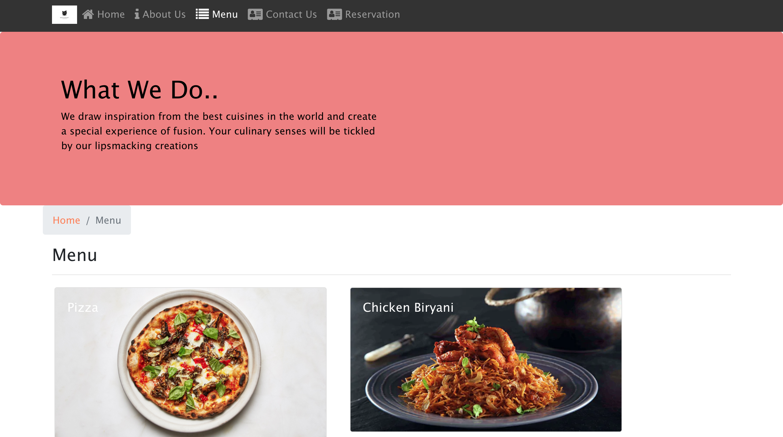

Slide 15
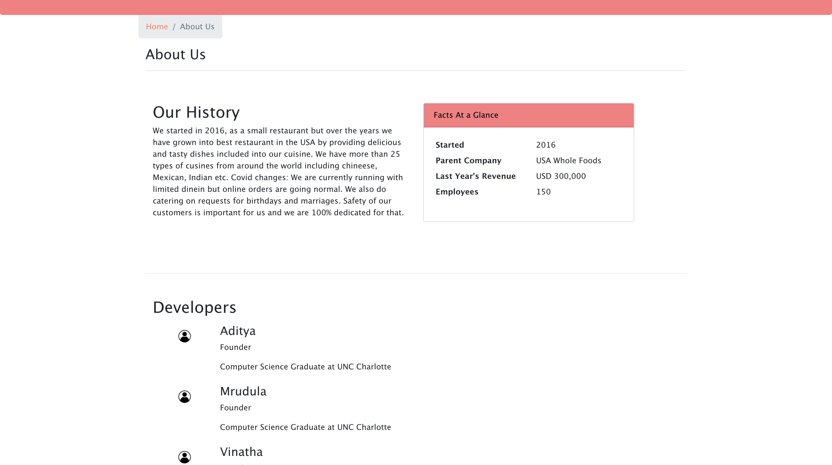

Slide 16
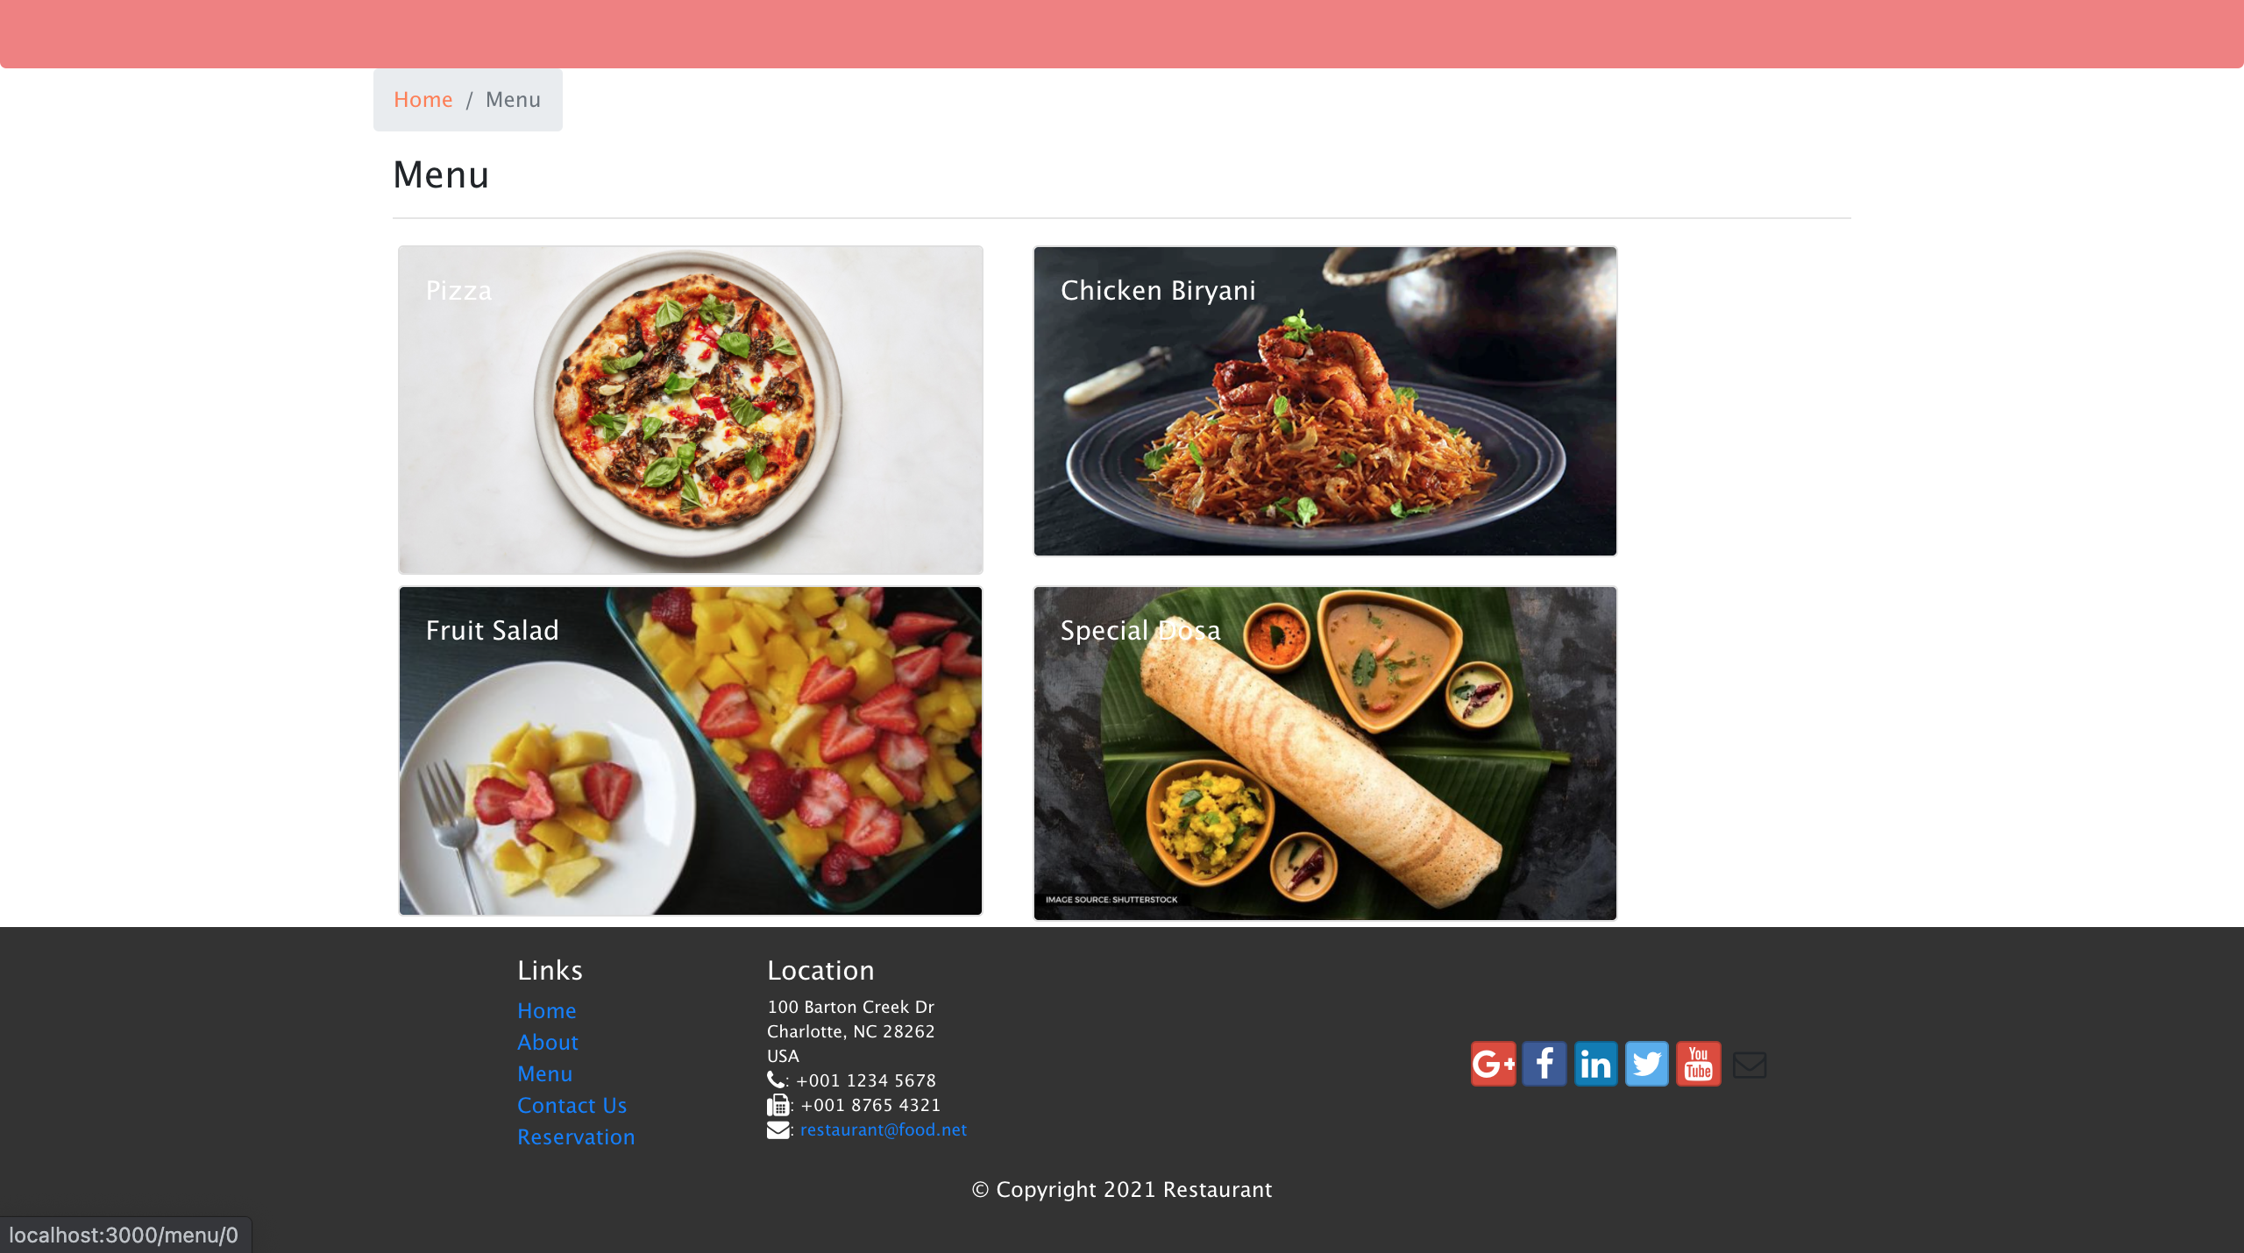

Slide 17
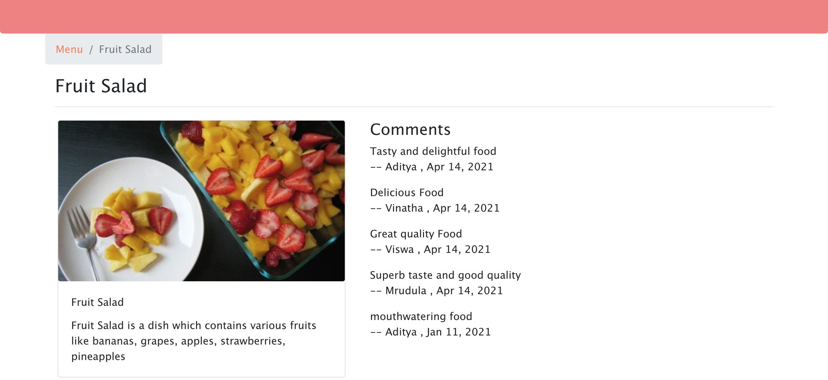

Slide 18
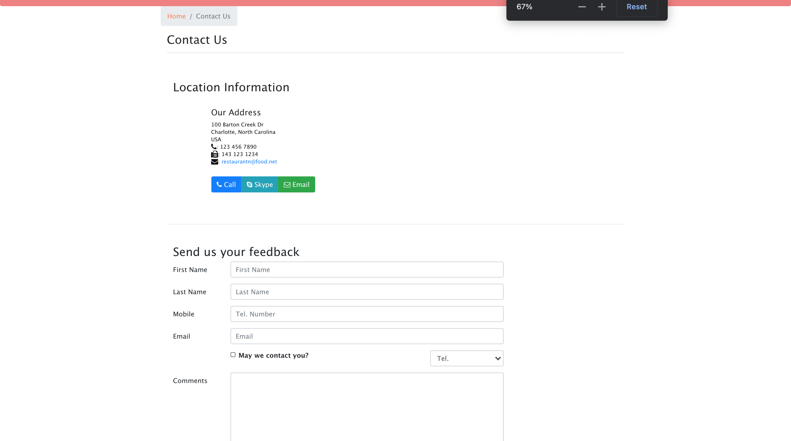

Slide 19
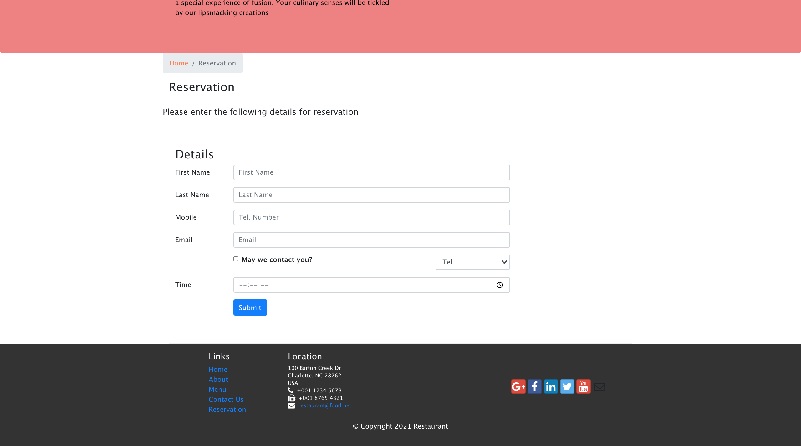

Slide 20
Conclusion
We used React component-based architecture to design this project, which divides the web application into multiple components, making it easier to manage and debug the code. React also provides powerful JSX syntax, which combines both xml and JavaScript syntax to make it easier to construct react components. This JSX syntax is used to provide both markup and logic in the same file, allowing the view to be rendered more quickly.
One-way data binding is a feature of React that allows data to flow only in one direction from parent to child components. This helped us during the debugging process since the data flow is only in one direction. Before altering the initial DOM, React creates Virtual DOM. When an update is performed, this Virtual DOM is modified, and the updated virtual DOM is compared to the original DOM, only updating the properties that have changed. This facilitates the fast and cost-effective rendering of our website.

Slide 21

Thank You

